Slide 1
GO Team Budget Allocation Meeting L.P. Miles Elementary January 30, 2025

Slide 2
Agenda
Action Items
Approval of Agenda
Approval of Previous Minutes
Strategic Plan Review and Update (if not previously completed)
Rank Strategic Priorities (if not previously completed)
Discussion Items
Changes to Gifted Delivery Model (if applicable – remove this line if not applicable)
Review Budget Meeting Schedule- Review and update meeting calendar
Budget Allocation Presentation
Information Items
Principal’s Report
CCRPI (if not previously presented)
Additional items as needed
Committee Reports (if applicable)
Cluster Advisory Report (if applicable)
Announcements
Public Comment (if applicable)
Adjournment

Slide 3
Action Items: Preparing for Budget Development

Slide 4
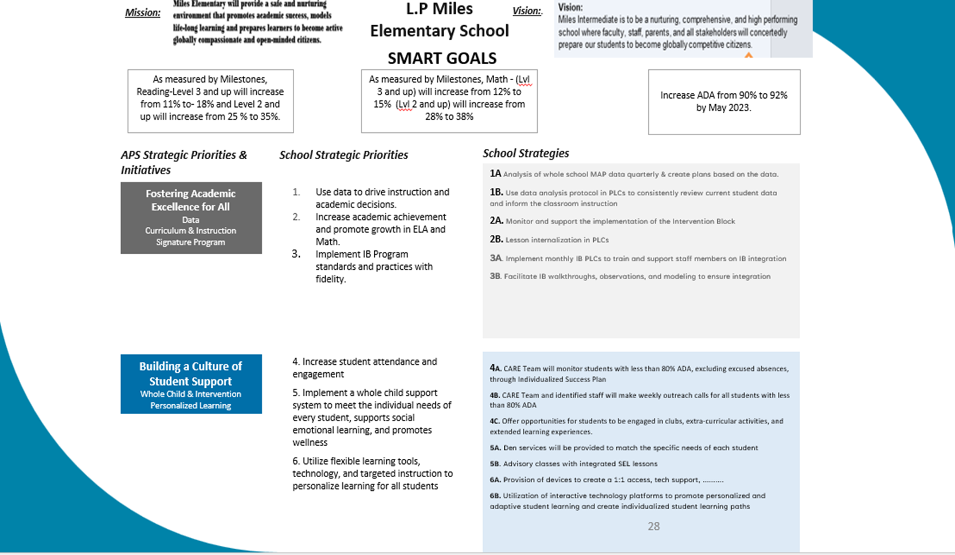
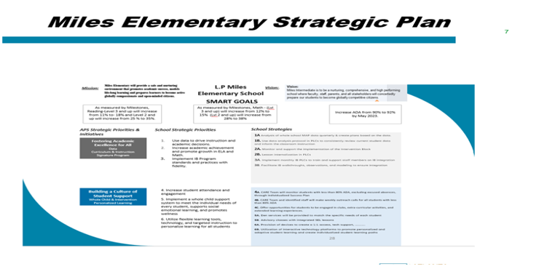
Our Strategic Plan

Slide 5
Our Strategic Plan

Slide 6
Discussion Items

Slide 7
Review & Discuss FY26 GO Team Budget Meeting Schedule
To ensure alignment with the district's budget timeline, we need to review and potentially adjust our current budget meeting schedule. This will ensure timely submission of all required materials.

Slide 8
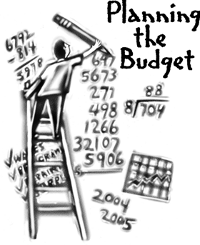
Overview of the FY26 GO Team Budget Process
Step 2 Principals Workshop FY 26 Budget
January 15th
Step 4 Principals Cluster Supt. Discussions
Step 1 Update Strategic Plan & Rank Priorities
Step 7 Principals HR Staffing Conferences Begin
Feb. 24th – Feb. 27th
Step 3 GO Team Budget Allocation Meeting
January 15th – January 31st
Step 8* GO Team Final Budget Approval Meeting
Budgets Approved by March 15th
Step 6 Cluster Supt. Review February 17th-21st
Step 5* GO Team Feedback Mtg. Early Feb. – Feb 14th
GO Teams are encouraged to have ongoing conversations
* GO Teams will need to take ACTION on the budget at these meetings.

Slide 9
Action on GO Team Budget Meeting Calendar
We will need to take ACTION (vote) to change our meeting calendar if we need to change our meetings to meet these deadlines:
Allocation Meeting: now-Jan 31 (today’s meeting)
Feedback Meeting: before February 14 (scheduled for 2/13)
Approval Meeting: after staffing conference and before Friday, March 14 (scheduled for 3/6)

Slide 10
Budget Development

Slide 11
Norms
This is a meeting of the GO Team. Only members of the team may participate in the discussion. Any members of the public present are here to quietly observe.
We will follow the agenda as noticed to the public and stay on task.
We invite and welcome contributions of every member and listen to each other.
We will respect all ideas and assume good intentions.

Slide 12
GO Team Budget Development Process
YOUR SCHOOL STRATEGIC PLAN…
is your roadmap and your role.
It is your direction, your priorities, your vision,
your present, your future.
Step 1: Data Review
Step 2: Strategic Plan Review
Step 3: Budget Parameters
(Strategic Priorities)
Step 4: Budget Development Process

Slide 13
Budget Allocation Meeting
What
During the first GO Team meeting the principal will provide an overview of the budget and position allocations, request(s) for turnaround and/or signature program funds and review changes to the Gifted Services delivery model (as needed)
Why
This meeting provides an opportunity for the principal and GO Team to ensure alignment on the school’s key strategic priorities, gain a deeper understanding of the budget and position allocations, discuss the proposed requests for signature program funds and provide input to drive the development of the draft budget.
When
January 16 – January 31

Slide 14
FY26 Budget Development Process
Principal’s Role
Design the budget and propose operational changes that can raise student achievement
Formulate strategies, implement and manage them at the school level
Focus on the day-to-day operations
Serve as the expert on the school
Hire quality instructional and support personnel
Collaborate with the GO Team on the use of school-level flexibility for position allocations, turnaround initiatives, and Signature Programs (NEW PROCESS FOR FY26)
The GO Team’s Role
Focus on the big picture (positions and resources, not people)
Ensure that the budget is aligned to the school’s mission and vision and that resources are allocated to support key strategic priorities
Collaborate with the Principal on the use of school-level flexibility for position allocations, turnaround initiatives, and Signature Programs (NEW PROCESS FOR FY26)

Slide 15
Miles Elementary Strategic Plan

Slide 16
Miles Elementary Strategic Plan

Slide 17
Miles Elementary Strategic Plan
Priority Ranking
Higher
Lower

Slide 18
FY 26 Budget Parameters
FY26 Ranked School Priorities | Rationale
Increase academic achievement and promote growth in ELA and Math by using data to drive instruction and academic decisions for our Sped Sub groups | Per our data, students in our Sped subgroup need maximized opportunities for achievement and remediation daily so that their individual academic needs are met
Implement IB program standards and practices with fidelity | IB is the signature program for the Mays Cluster and will ensure that students experience rigorous, quality academic programming.
Build teacher capacity to support academic achievement. | Use student data to provide professional development for teachers.

Slide 19
Discussion of Budget Allocation

Slide 20
Executive Summary
This budget represents an investment plan for our school’s students, employees and the community as a whole.
The budget recommendations are tied directly to the school’s strategic vision and direction.
The proposed budget for the general operations of the school are reflected at $8,292,302
This investment plan for FY26 accommodates a student population that is projected to be 469 students, which is an increase of 23 students from FY25.

Slide 21
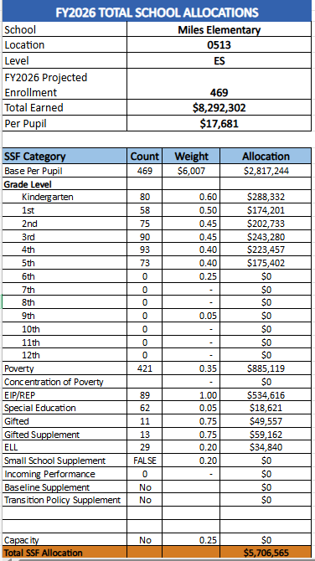
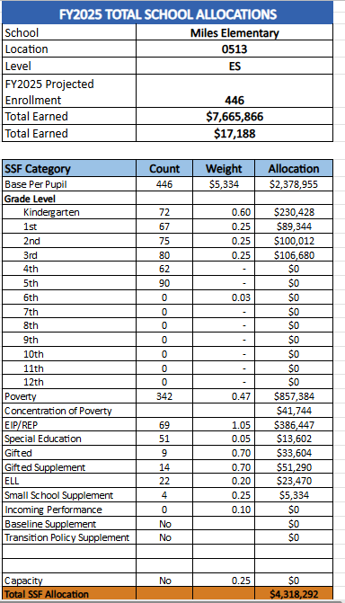
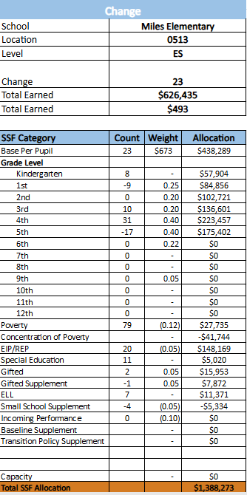
School Allocation Tab Overview
The Allocation Tab has 3 tables that show the allocations for FY26, FY25, and the Change in each area. This helps you understand how our school earned funds and positions for FY26 in comparison to FY25, and how changes in each line impact our overall school budget.

Slide 22
Miles Additional Earnings

Slide 23
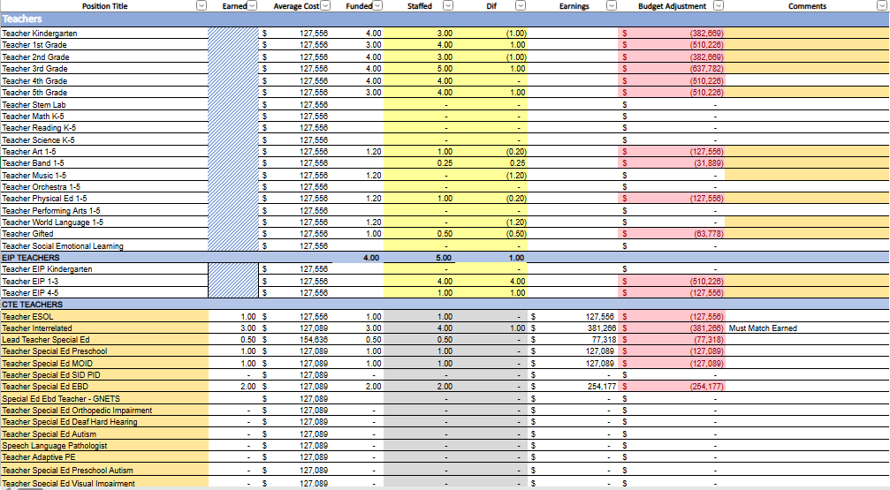
Summary Tab Overview
The Summary Tab provides a summary of the staff in our school. The columns show how many positions are:
Earned – positions allocated by district departments. There is no school-level flexibility with these positions.
Funded – District’s recommended staffing for positions where there is school-level flexibility with staffing the position.
Staffed – This shows how the position is currently staffed at the school.
Difference—This shows the difference between the recommendation in the Funded column and the Staffed Column.
Comments: The principal must provide comments if there is a difference in what is Funded and Staffed. Principals and GO Teams will discuss the rationale provided for the Comments section.

Slide 24
Summary Tab

Slide 25
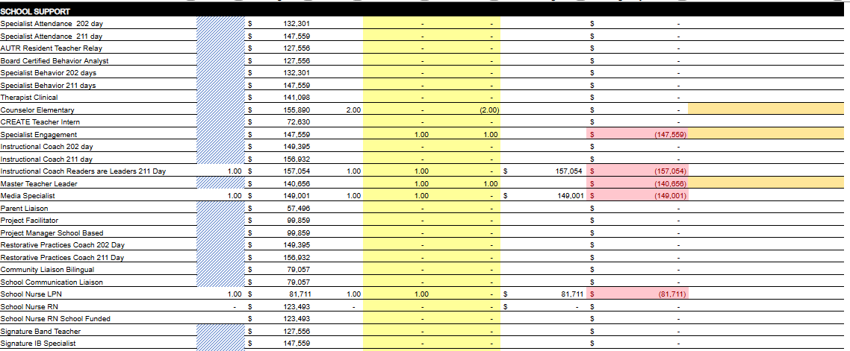

Slide 26
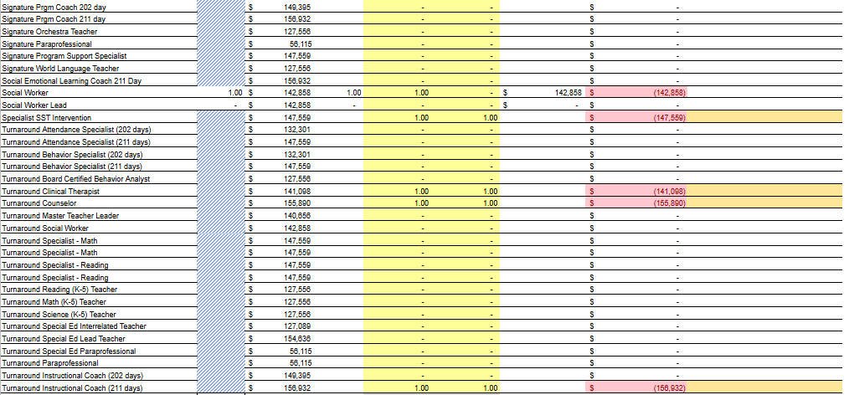

Slide 28
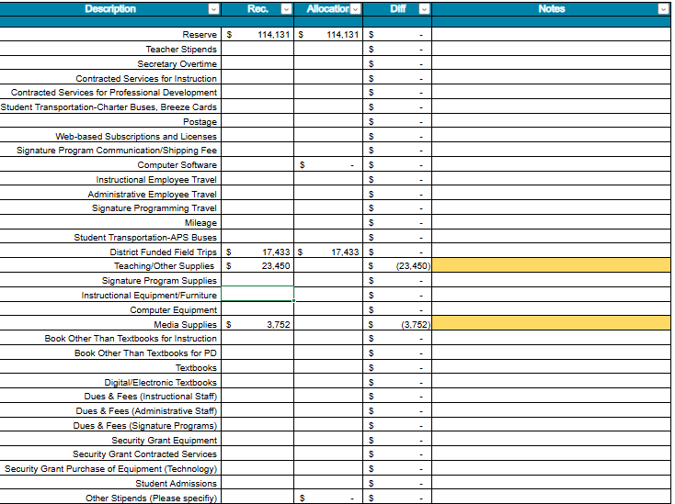
Non-Staffing Tab Overview
The Non-Staffing Tab shows how funds are allocated for non-staff items in the school. There is school-level flexibility for most of these items. The tab has columns for:
Recommended—District’s recommended amount to spend on the line item.
Allocation – This shows how much money has been allocated towards the line item.
Difference—This shows the difference between the recommended amount and the allocation.
Notes: The principal must provide comments if there is a difference in what is Recommended and what is Allocated. Principals and GO Teams will discuss the rationale for the notes section.

Slide 29
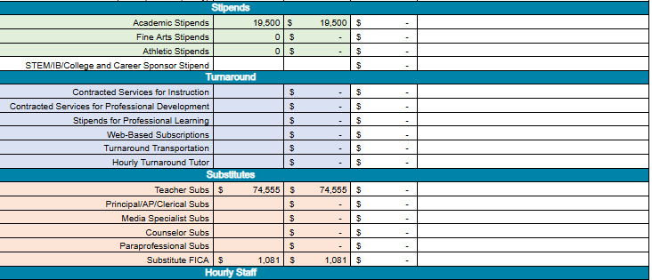
Non-Staffing Tab Overview

Slide 30
Signature and Turnaround Fund Process Overview
Overview
* The district is piloting a zero-based budgeting (ZBB) process for Signature and Turnaround Program Funds this year.
* Zero-based budgeting (ZBB) is a budgeting process that allocates funding based on program efficiency and necessity rather than budget history. As opposed to traditional budgeting, no item is automatically included in the next budget.
* As such the initial allocation for these programs at all schools will be $0.
Process
* Principals will develop proposed requests for the personnel and non-personnel they need to support the Signature and/or Turnaround Programs at their schools.
* Principals will share and discuss their proposals and rationale for the proposals with their school GO Team for feedback.
* After discussing with their GO Team, principals will submit their request for review by January 31st. Funding for these programs will be provided the week of February 3rd.

Slide 31
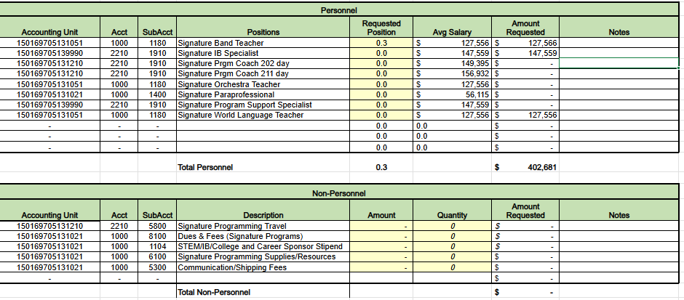
Proposed FY26 Signature Program Fund Request

Slide 32
Proposed Rationale for FY26 Signature Program Fund Requests
FY26 Signature Program Fund Request | Rationale
Continue to have an IB Specialist to support IB implementation. | Ensure that staff and students receive support and professional learning to implement the IB program.
Continue to have a World Languages teacher | Ensure we meet the standards of service for world languages
Continue to have a band teacher | Ensure we meet the standards of service for Fine Arts

Slide 33
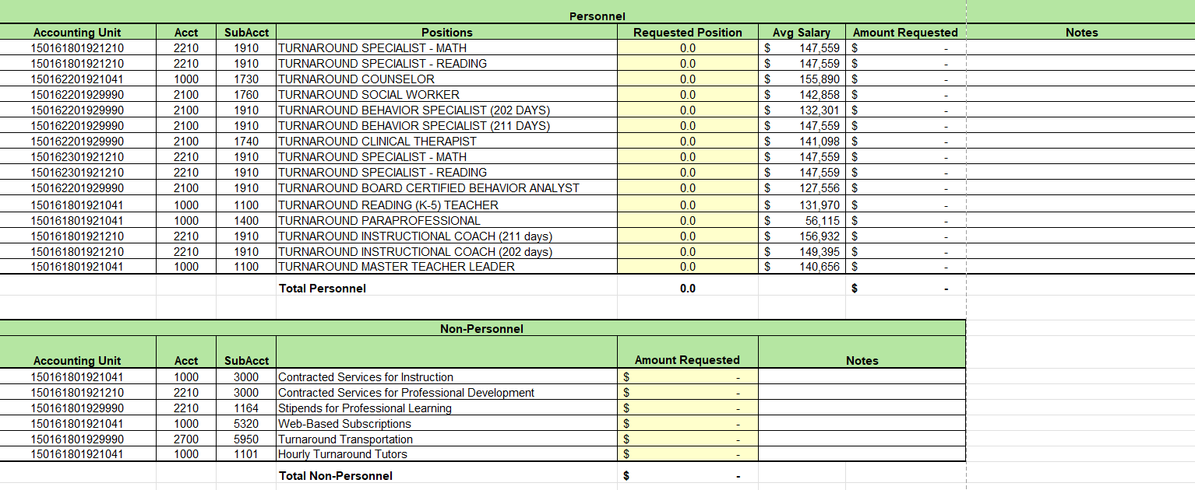
Proposed FY26 turnaround Program
Fund Request
We are requested Turnaround Funds for certain positions based on data and services needed

Slide 34
What’s Next?
February
GO Team Feedback Meeting(s) before February 14th
ACTION (i.e.- GO Team votes) on draft budget before February 14th
Cluster Superintendent Review (February 17-21)
HR Staffing Conferences (February 24– February 27)
March
Final GO Team Approval Meeting (AFTER your school’s Staffing Conference and BEFORE Friday, March 14th)
ACTION (i.e.- GO Team votes) on final budget recommendation before March 14

Slide 35
Questions?
Thank you for your time and attention.

Slide 36
Information Items

Slide 37
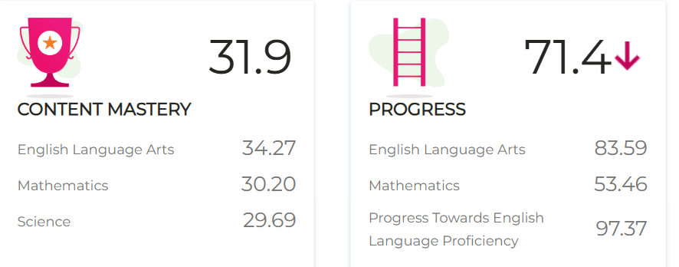
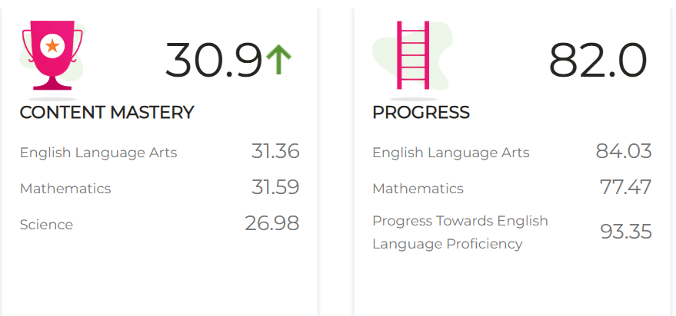
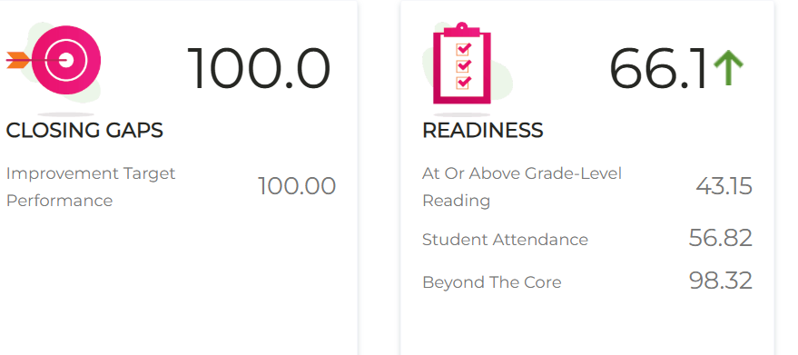
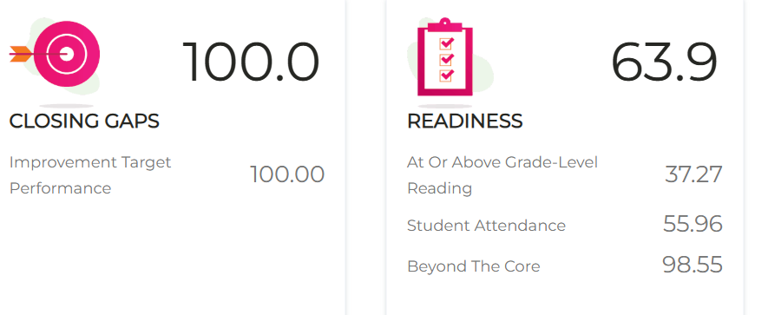
Principal’s Report
2024 CCRPI Results
2023 CCRPI Results

Slide 38
CCRPI

Slide 39
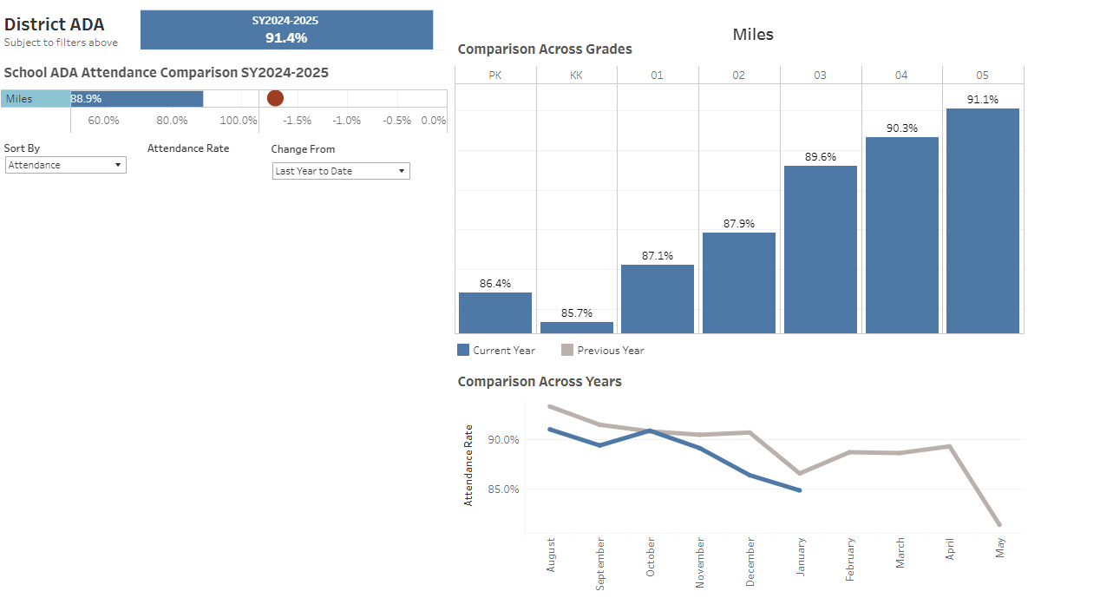
Information about our school

Slide 40
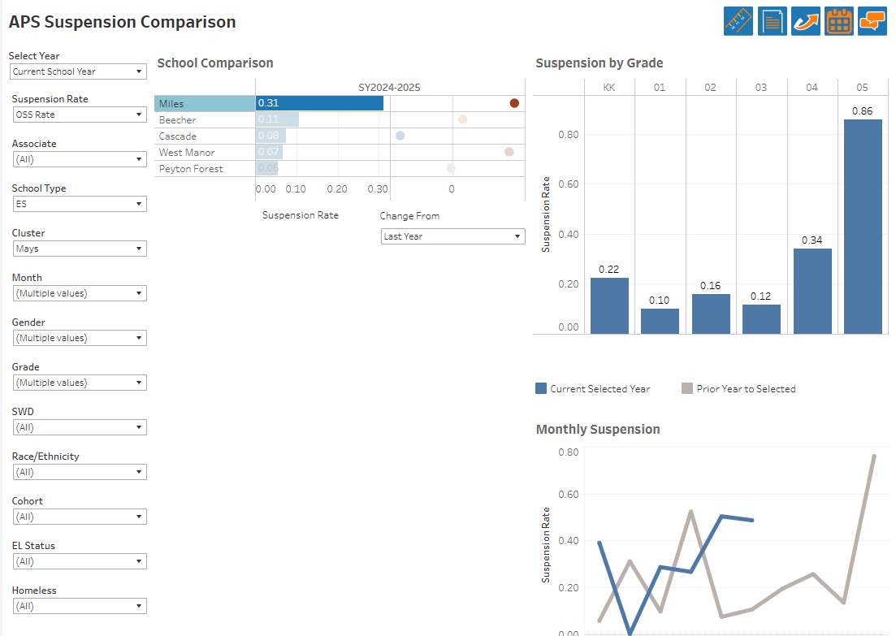
Information about our school

Slide 41
Thank you

